Slide 1
Stylex Source code presentation

Slide 2

GROUP 1
Vineet Sanjay Tamhane (Project Manager)
Sharath Vemulapally (Product Owner)
Siva Sai Palla (Business Analyst)
Varsha Anand Fnu (Lead Developer)
Honghao Zhu (Developer)
Somil Saparia (DBA)
Anirudh Uppaluri (QA)
Kunj Patel (Software Tester)

Slide 3
GROUP 2
Venkata Sai Kandikattu Rohith (Project Manager )
Kalpana Komatineni (Product Owner)
Sakshi Pandirkar (Business Analyst)
Gauri Gupta (Lead Developer)
Ram Prakash Babu (Developer)
Pranit Kumbhar (DBA)
Dhivya Elango (QA)
Nikhil Gavini (Software Tester)

Slide 4
Contents
GitHub Repository
Project Documents
Jenkins Pipeline
Development Source Code

Slide 5
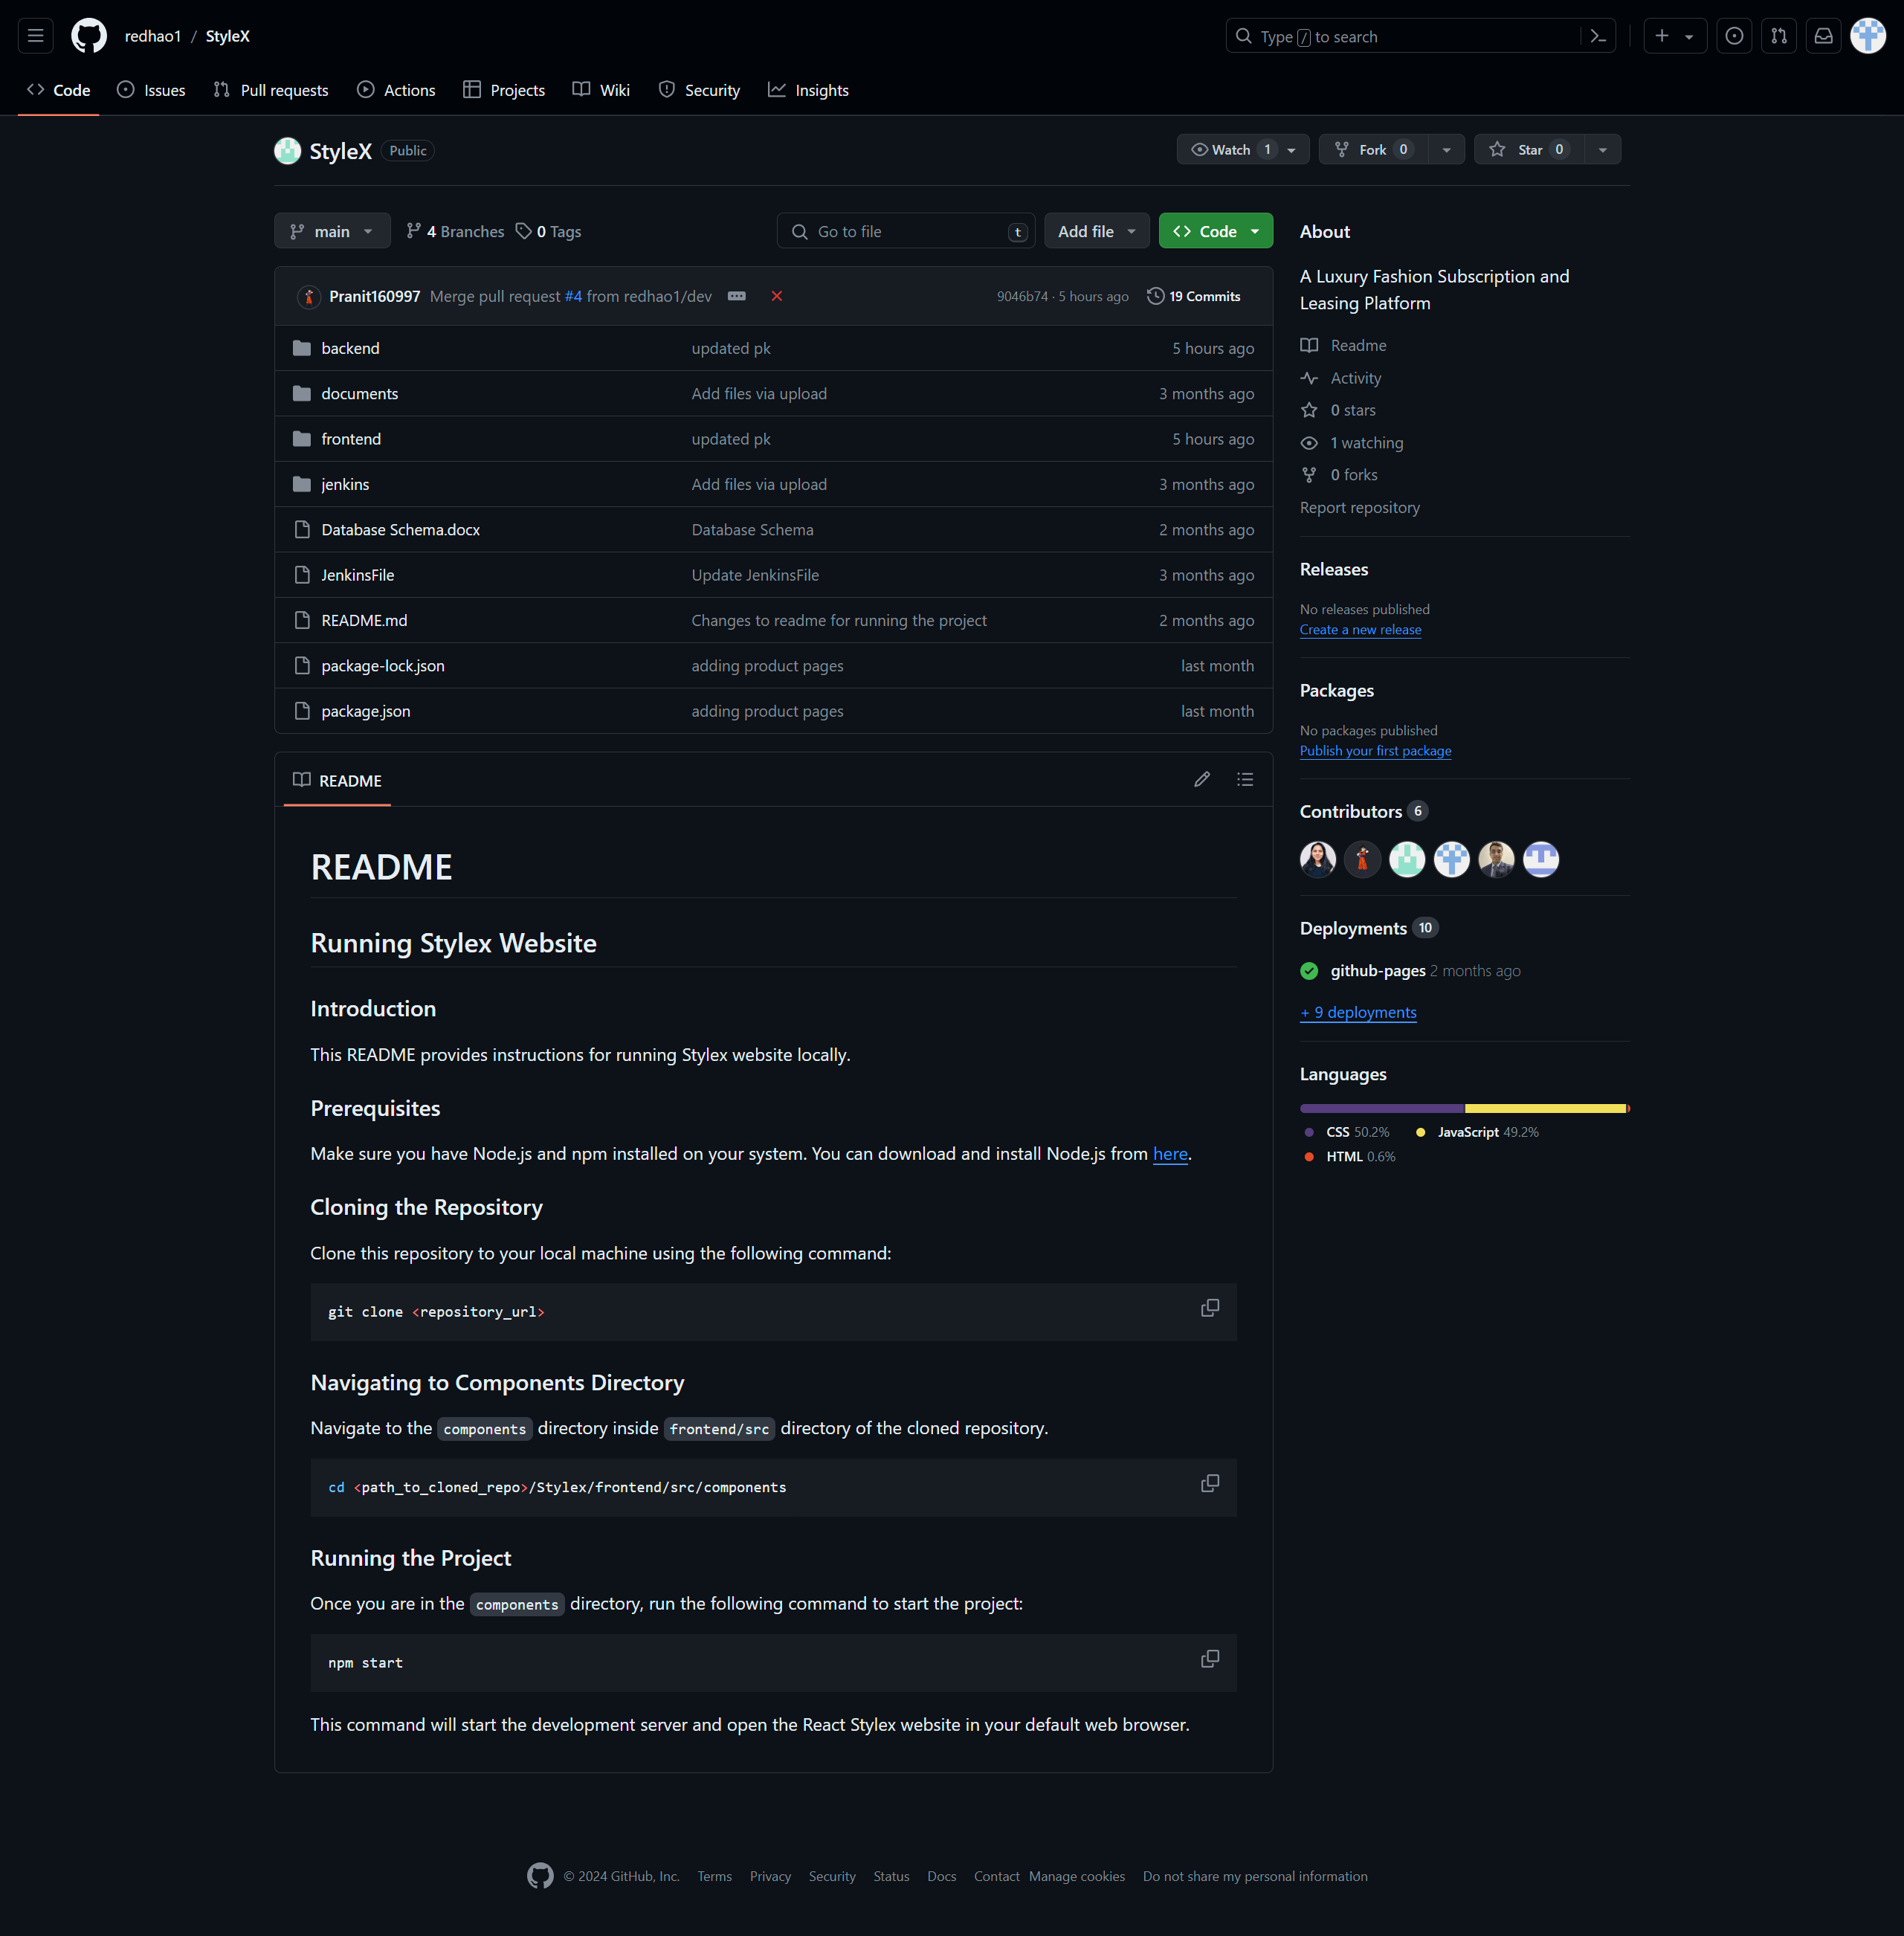
Repository structure

Slide 6
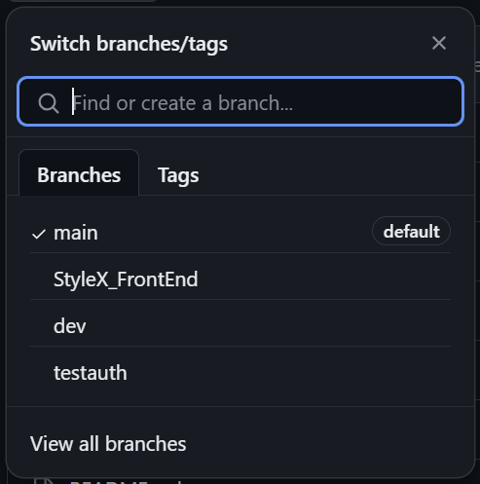
All branches

Slide 7
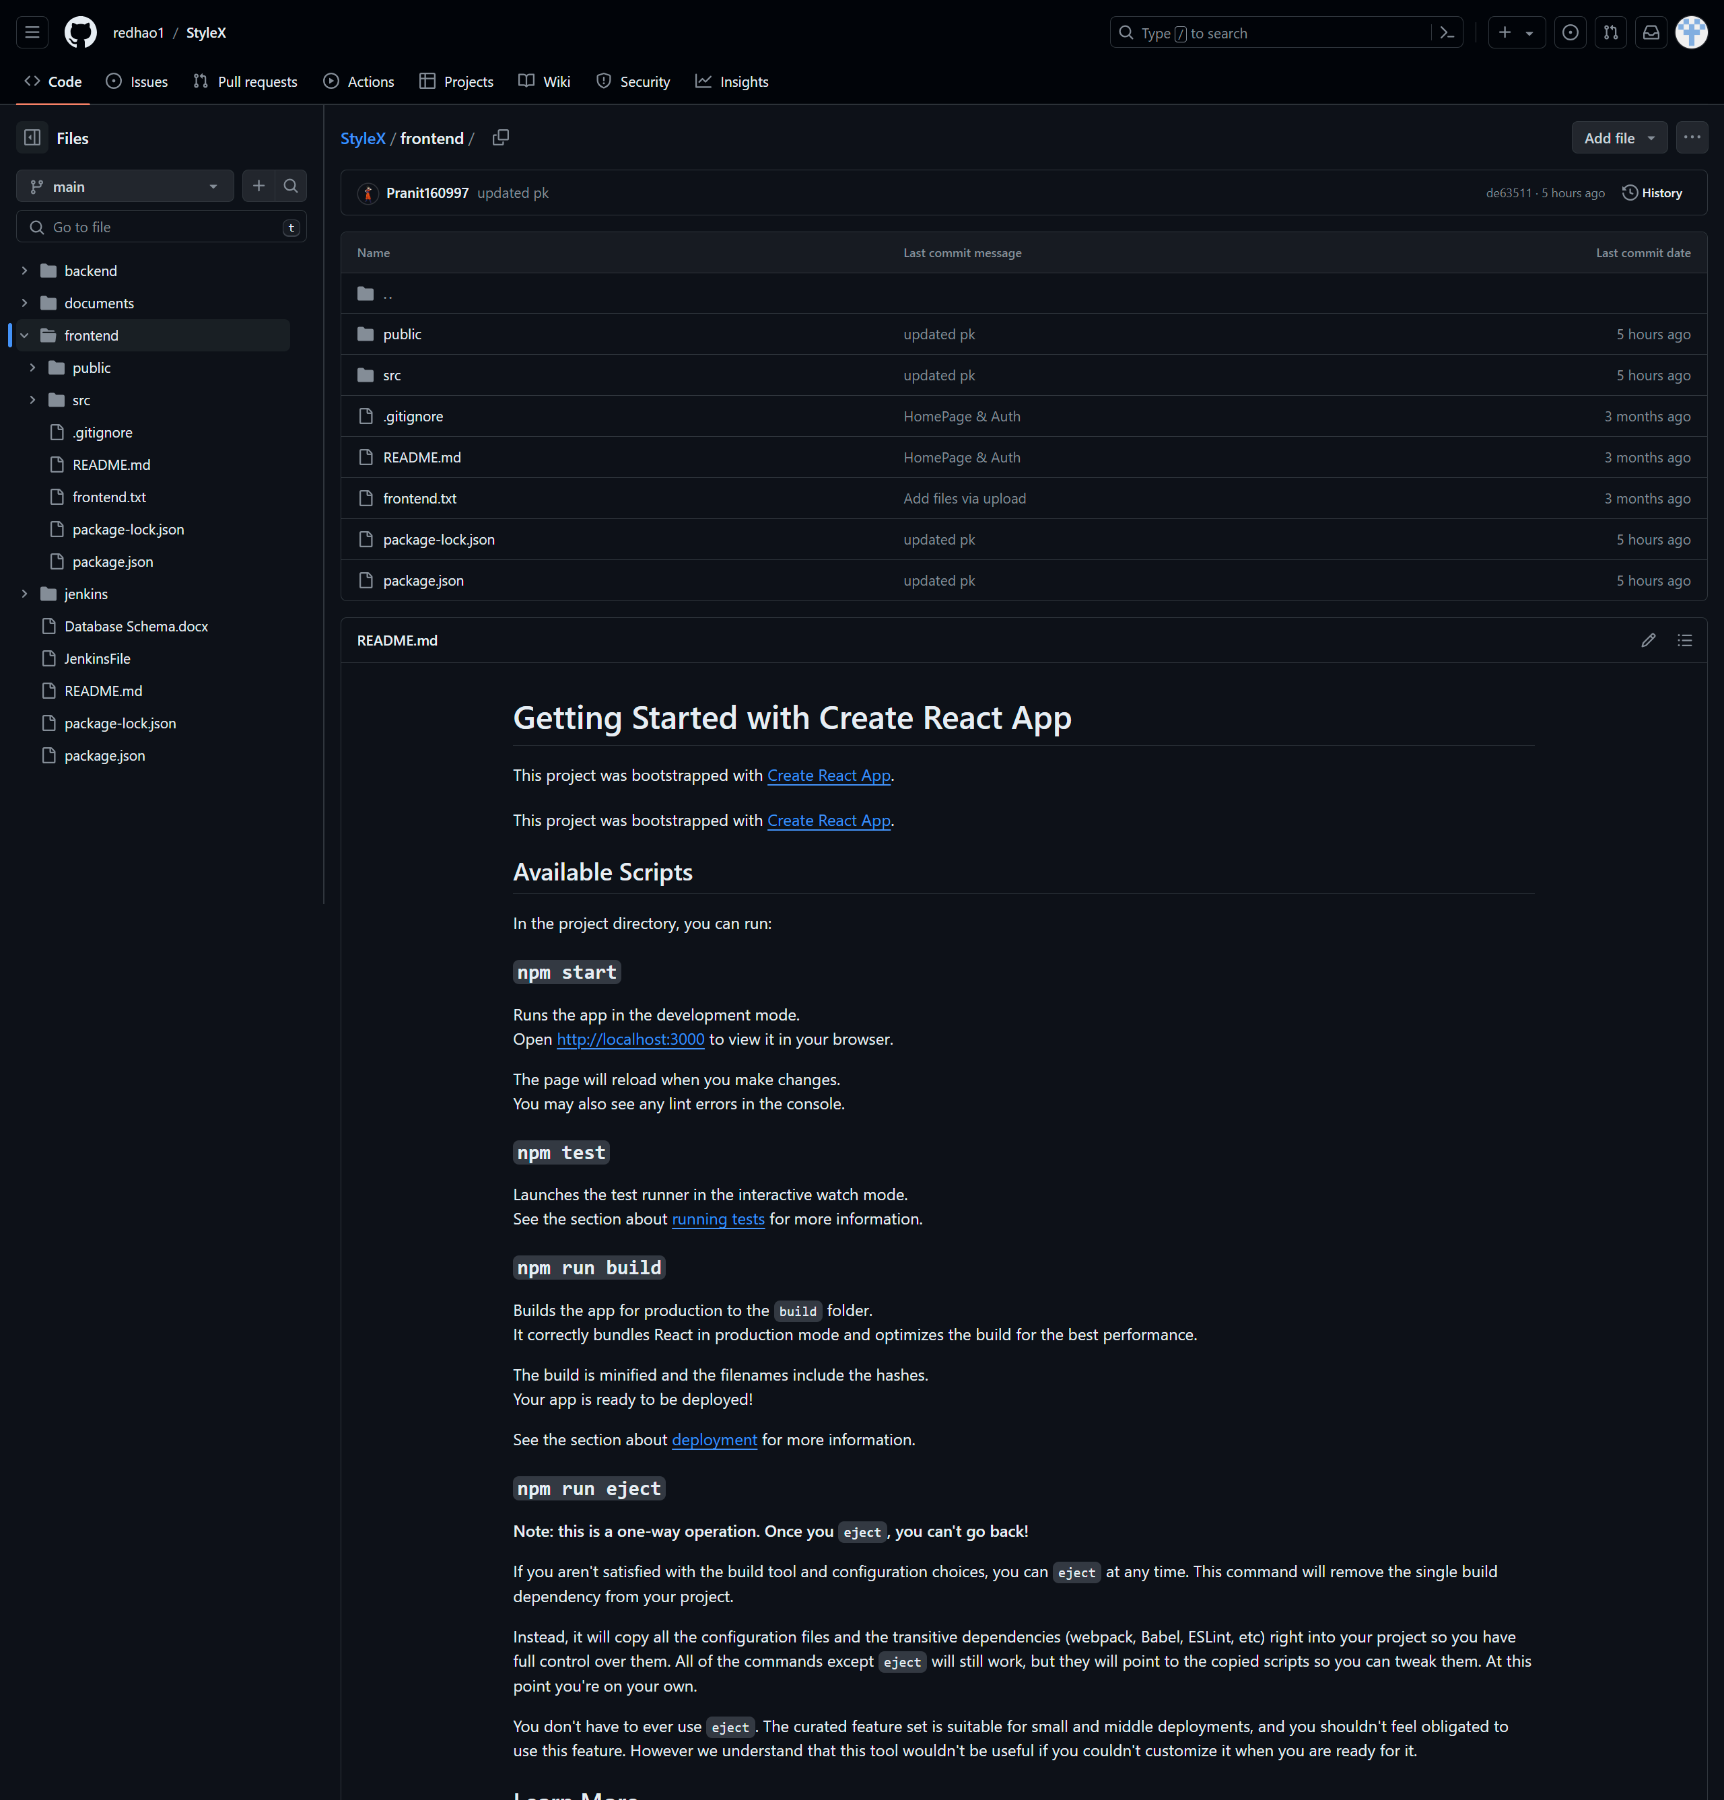
Frontend file structure

Slide 8
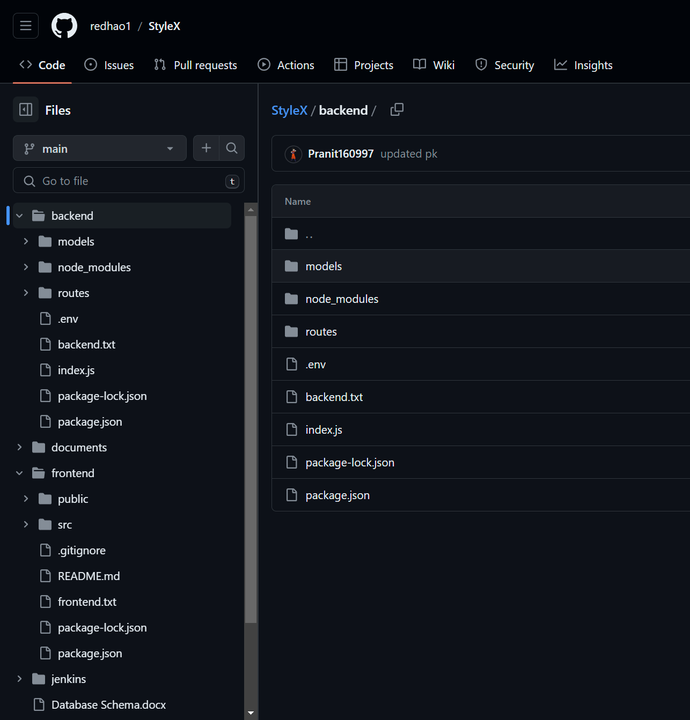
Backend file structure

Slide 9
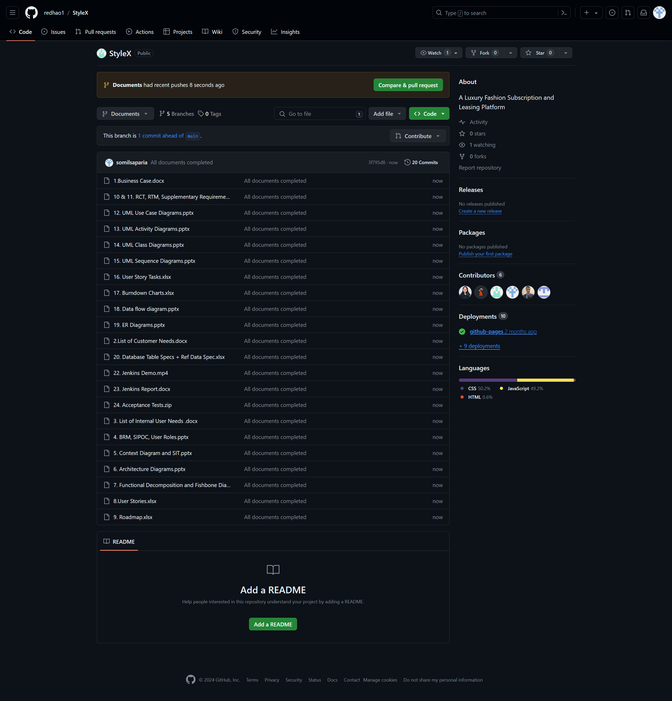
Project documents

Slide 10
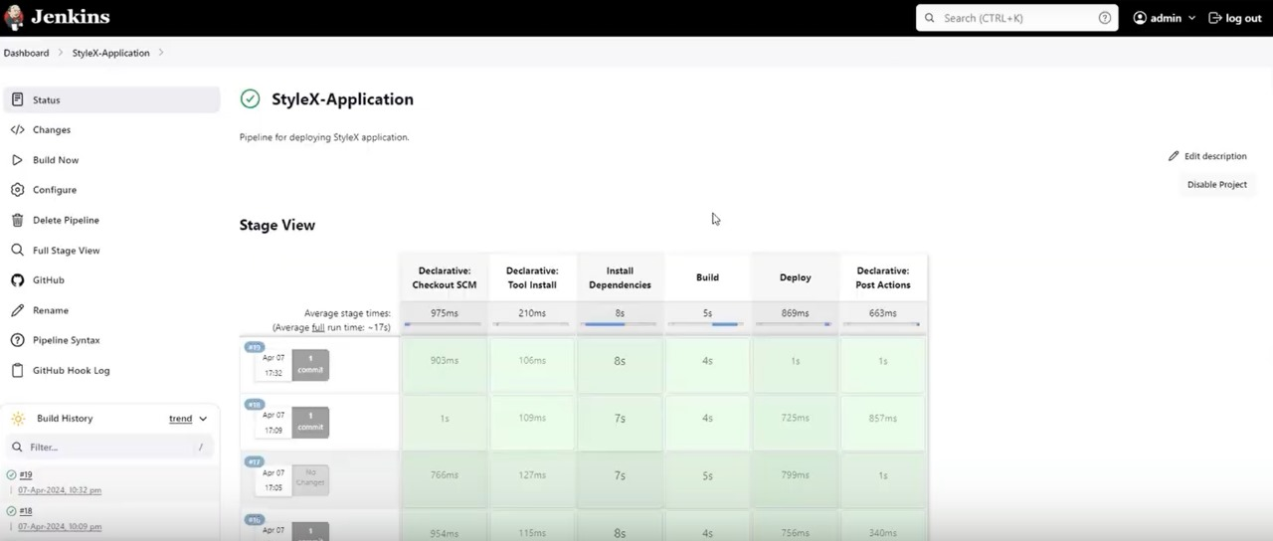
Jenkins pipeline Deployment

Slide 11
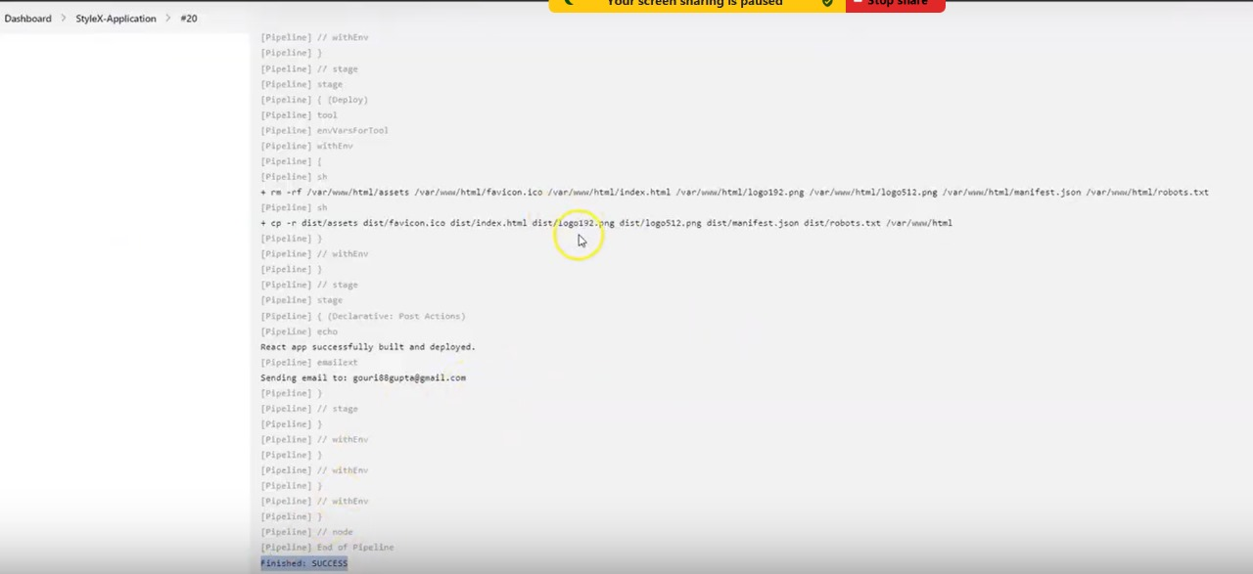
Jenkins pipeline Deployment

Slide 12
prerequisites
MongoDB
Node.js
React.js

Slide 13
Source code

Slide 14
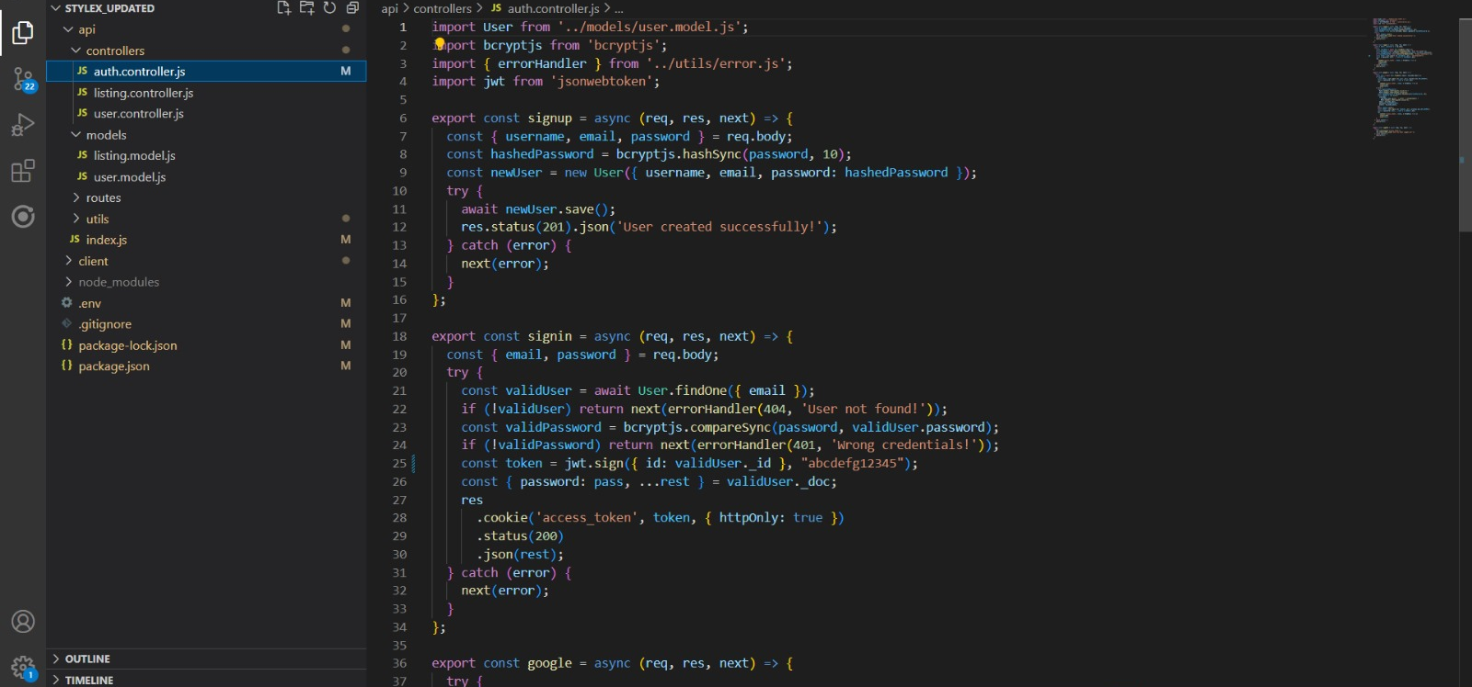
User Authentication

Slide 15
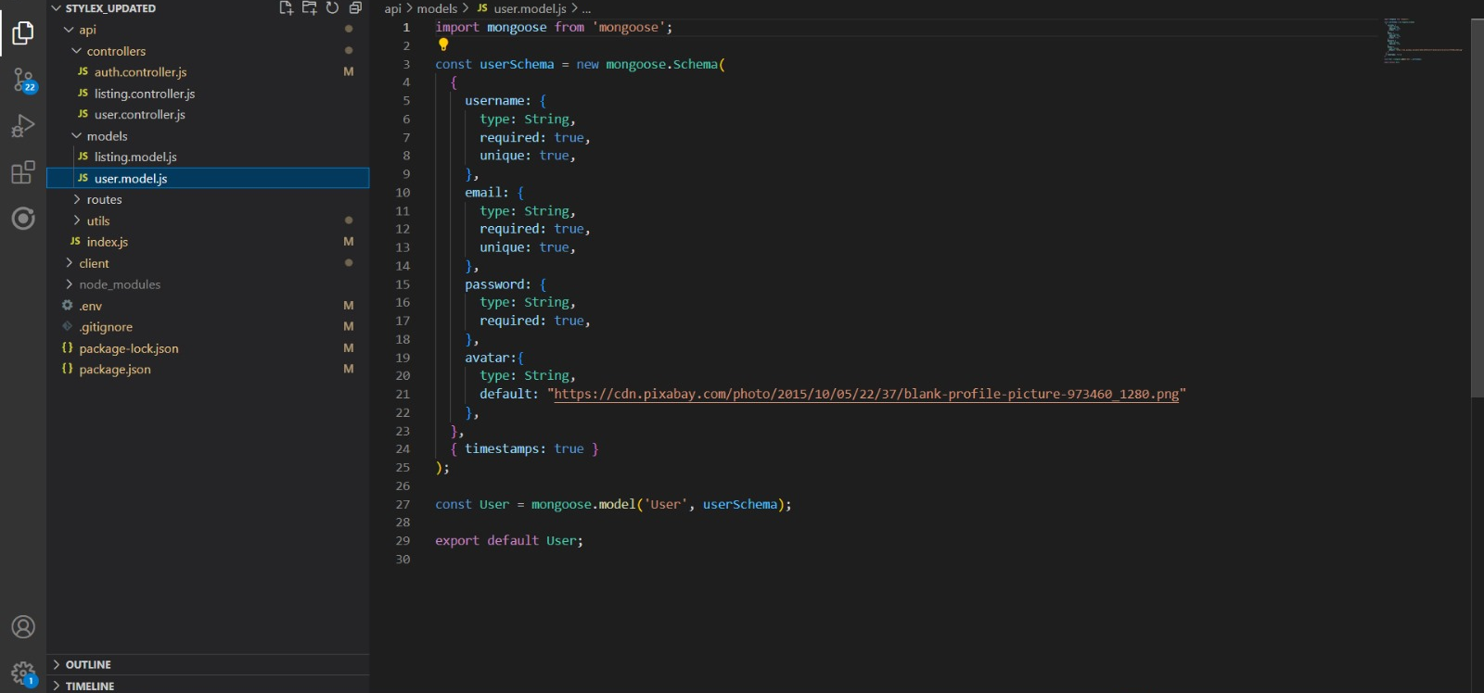
User profile model

Slide 16
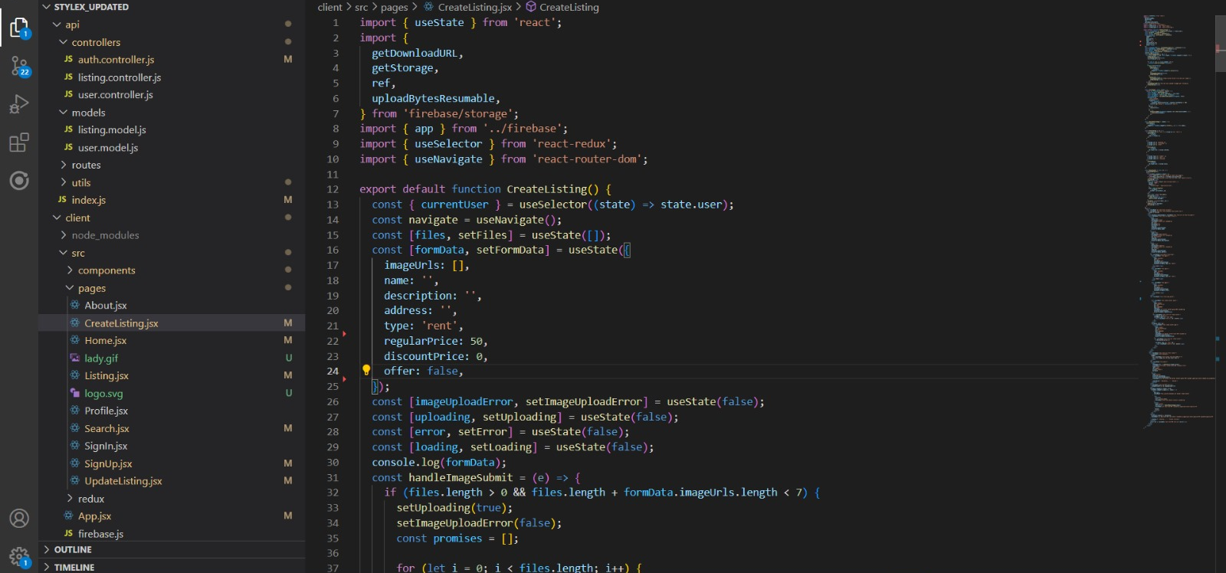
Product Listing function

Slide 17
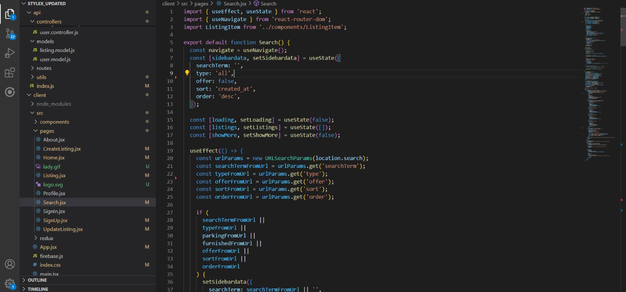
Search functionality

Slide 18
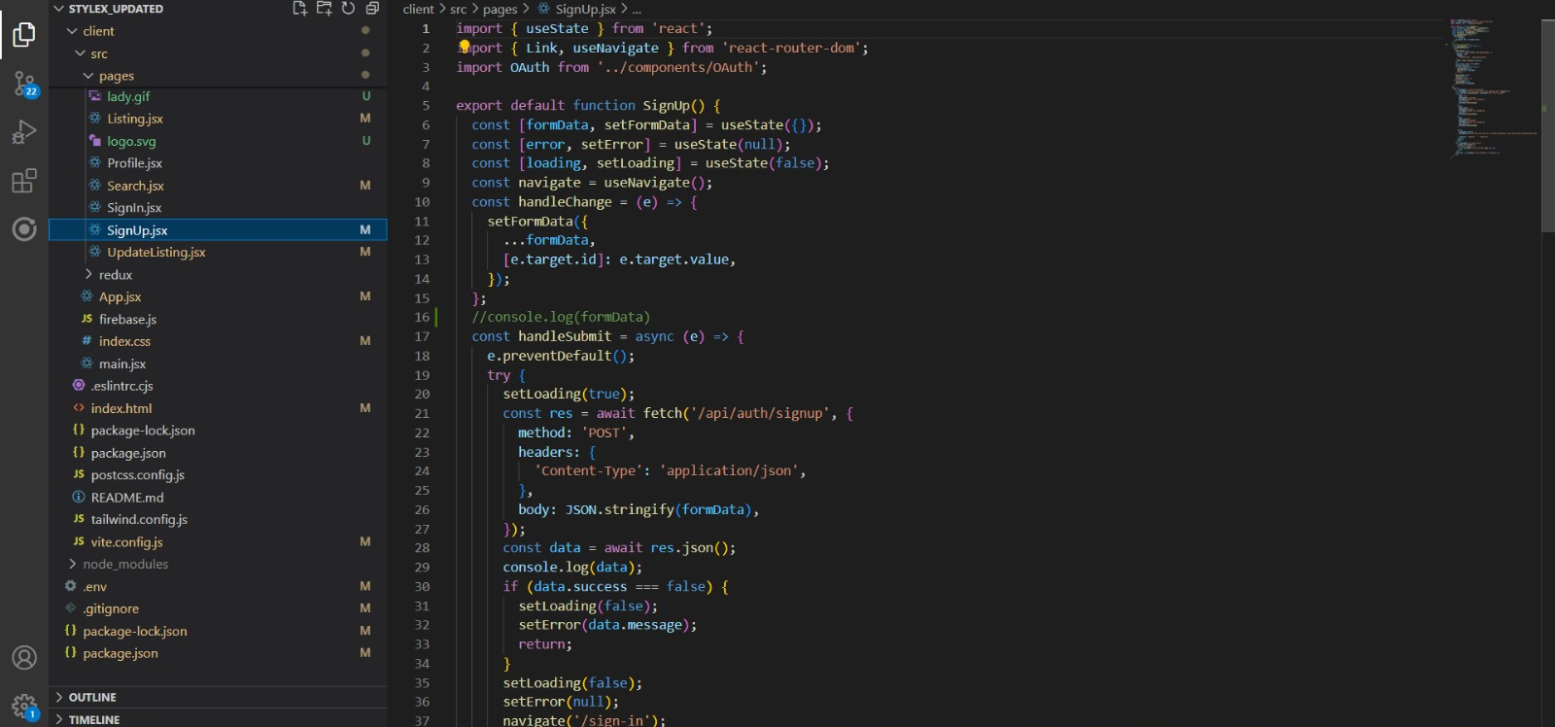
User signup function

Slide 19
THANK YOU
Team 1 - StyleX

